Slide 1
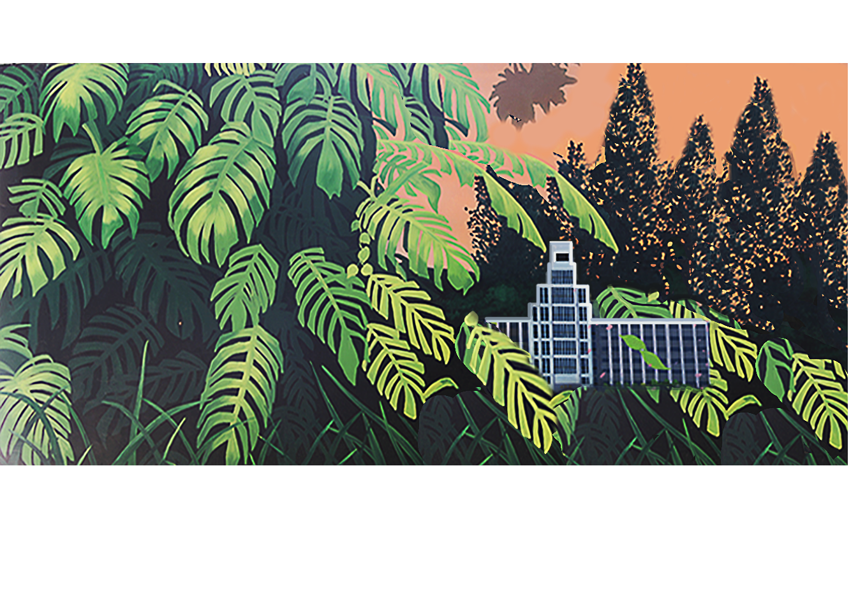

西安交通大学
Outline of China
Tittle: Introduction to Traditional Chinese Medicine
学院: 计算机科学与技术学院
专业: 计算机科学与技术
姓名: MD MAHFUZUR RAHMAN
中文名字：罗尼
学生号码： 3123999081

Slide 2
目录
Contents
1
Introduction
2
Fundamental Concepts
3
Diagnostic Methods
4
Treatment Modalities
5
Dietary Therapy and Mind Body Pratices
6
Modern Applications and Research
7
Conclusion

Slide 3

Introduction

Slide 4
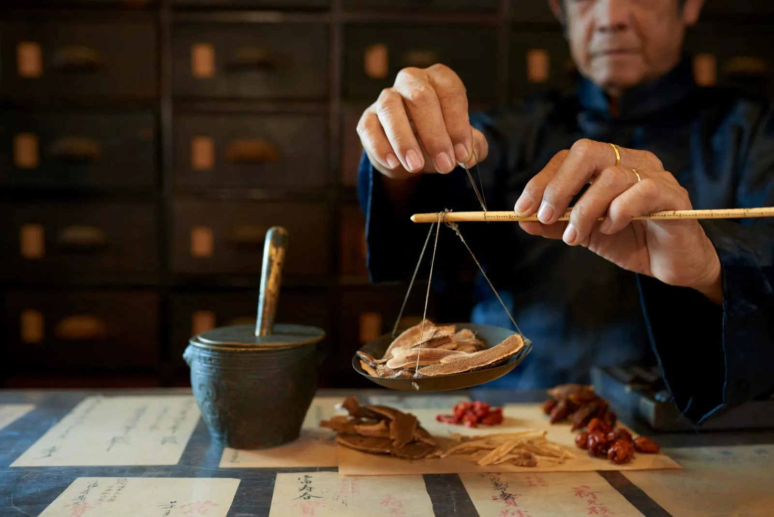
What is TCM?
Definition: A holistic approach to health originating in ancient China.
History: Over 2500 years old.
Key Principle: Balance and Harmony within the body and between the body and nature.

Slide 5
Fundamental Concepts

Slide 6
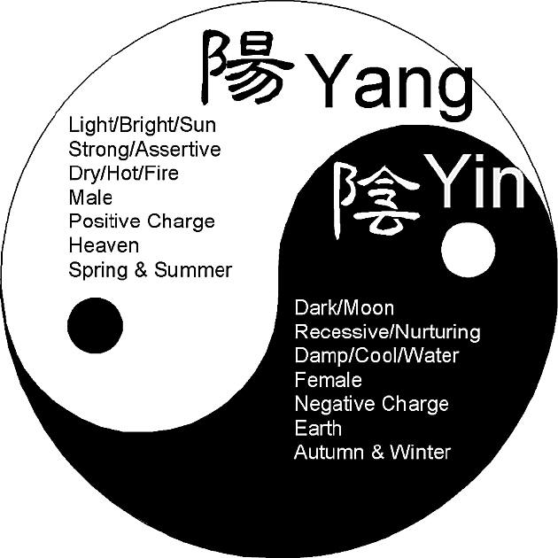
Fundamental Concepts
02
文本文本文本
Yin and Yang
Explanation: Dualistic nature of exixtence.
Balance: Essential for health.
Qi (chi)
Definition: Vital energy or life force.
Flow: Circulates through pathways called meridians.
请输入文字请输入文字请输入文字
请输入文字请输入文字

Slide 7
Diagnostic Methods

Slide 8
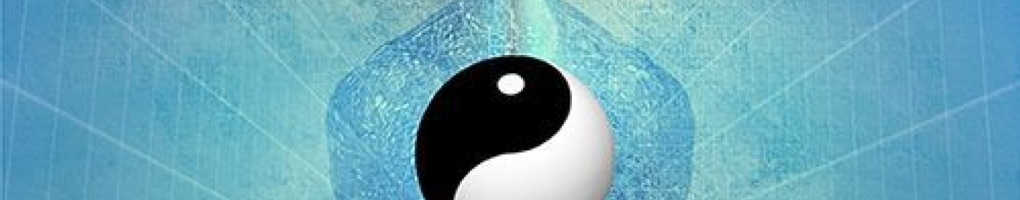
Diagnostic Methods
Four Main Diagnostic Techniques
Observation
Listening and Smelling
Inquiry
Palpation
Inspecting physical signs and behavior.
Sounds and odors.
Asking about symptoms and history.
Feeling the pulse and other body areas.

Slide 9
Treatment Modalities

Slide 10

Tretment Modalities
Acupuncture
Herbal Medicine
Cupping
Moxibustion
Description: Insertion of fine needles into specific points.
Purpose: To balance Qi flow.
Use: Combination of herbs to treat various conditions.
Form: Teas, powders. tablets.
Method: Placing cups on the skin to create suction.
Benefits: Pain relief, muscle relaxation.
Technique: Burning moxa near the skin.
Aim: To warm and invigorate the flow of Qi.

Slide 11
Dietary Therapy and Mind-Body Pratices

Slide 12
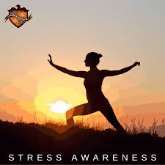
Dietary Therapy
Mind-Body Practices
02
文本文本文本
Food as Medicine
Principle: Foods have therapeutic properties.
Example: Warming foods for cold conditons.
Tai Chi and Qigong
Description: Gentle movements combined with breathing exercies.
Benefits: Improve balance, reduce stress, enhance overall well-being.
请输入文字请输入文字请输入文字
请输入文字请输入文字

Slide 13
Modern Applications and Research

Slide 14

Modern Applicatin and Research
Integration with Western Medicine
Collaboration: Complementary use in hospitals and clinics.
Research: Ongoing studies on efficacy and mechanisms.
Global Influence
Adoption: Increasing Popularity worldwide.

Slide 15
Conclusion

Slide 16
Conclusion
Summary
TCM’s holistic approach.
Importance of balance and harmony.
Continued relevance in modern healthcare.

Slide 17
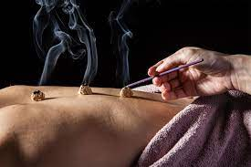
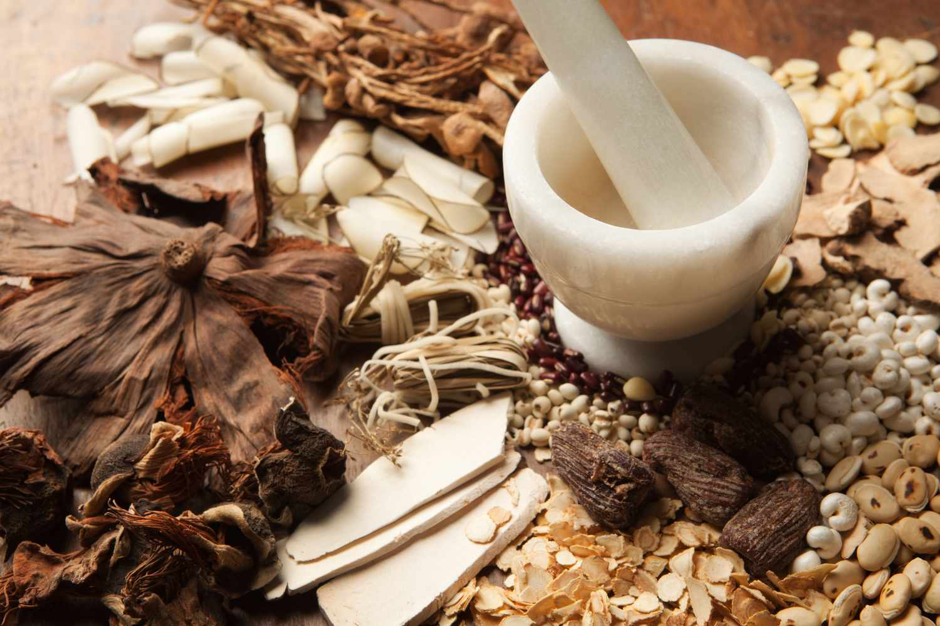

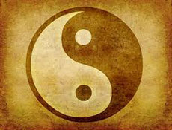
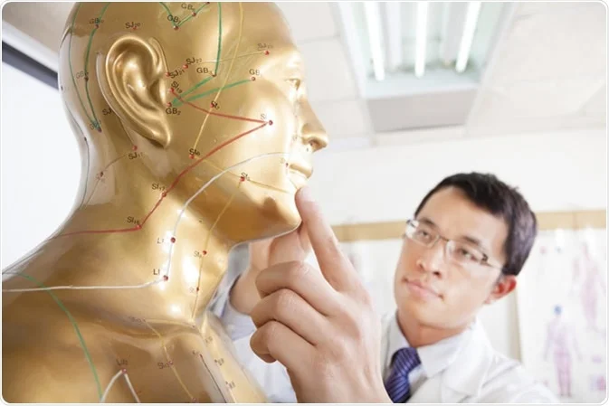
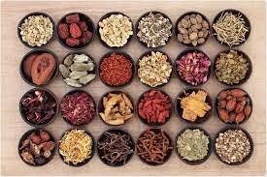
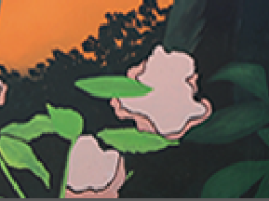
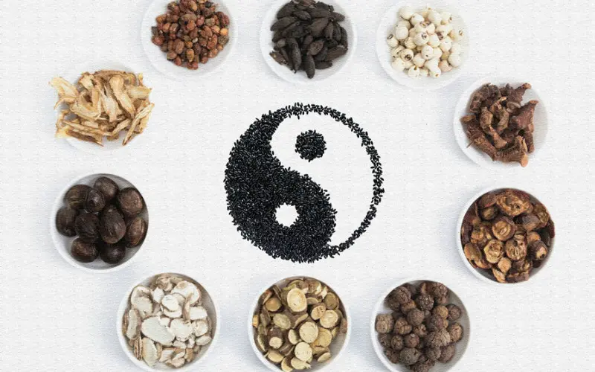
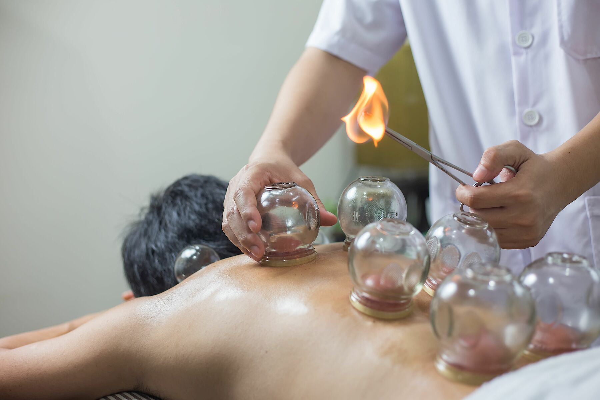
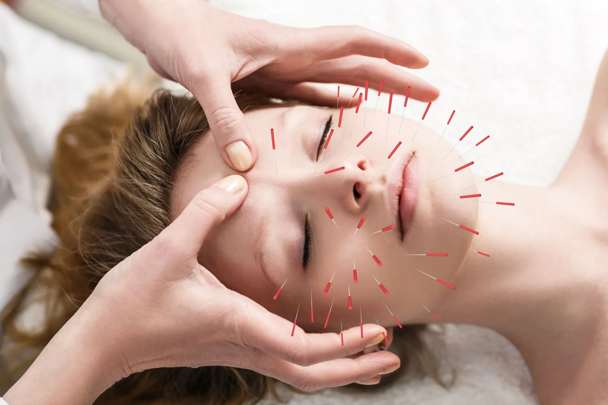
Thank You

